Slide 1

COVID-19 Vaccinations and their trends in the United States
Venkata Sri Ambica Mokarala
INFO 5709
Data Visualization and Communication

Slide 2
Agenda
Study vaccine trends across different states in US
Introduction
Datasets
Research questions
Methodology
Results
Conclusion and Future work

Slide 3
Introduction
COVID 19
Vaccinations
Side effects
Hesitancy

Slide 4
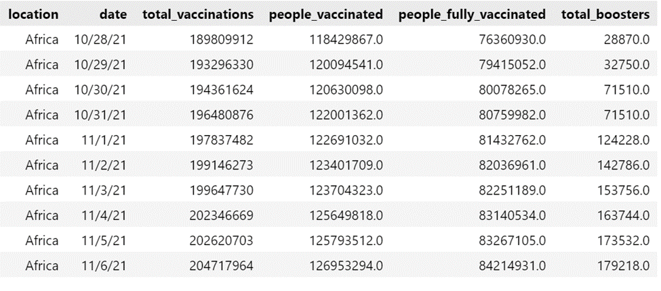
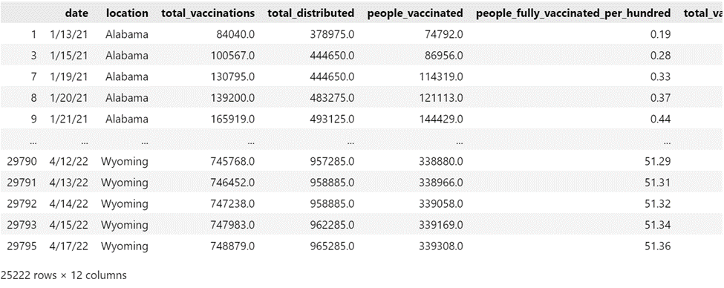
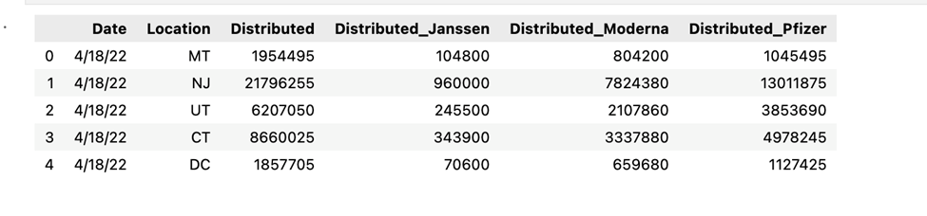
Datasets
Kaggle, CDC, California Health and Human Services Open Data Portal, Data.gov

Slide 5

Research Questions
How are the vaccination trends in different states across the United States?
What are the 5 states with the Highest vaccination and least vaccination?
What is the percentage of people who are vaccinated in the total vaccines distributed in different states?
What vaccine is more distributed or administered (Moderna/Pfizer/Johnson-Johnson) in the US?
Analyzing Country wise distribution of COVID 19 vaccines.

Slide 6



Methodology
EDA
Python
Microsoft PowerBI

Slide 7

Exploratory Data Analysis(EDA)
Univariate, Bivariate and Multivariate EDA
Python libraries used:
Pandas
NumPy
Seaborn
matplotlib

Slide 8
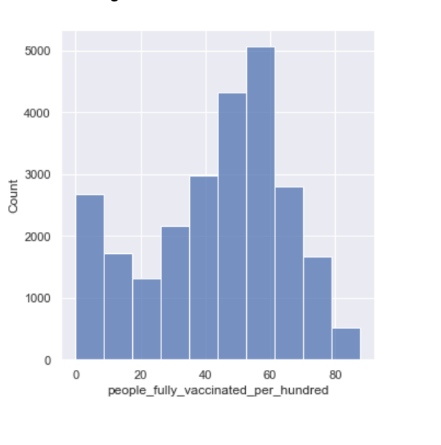
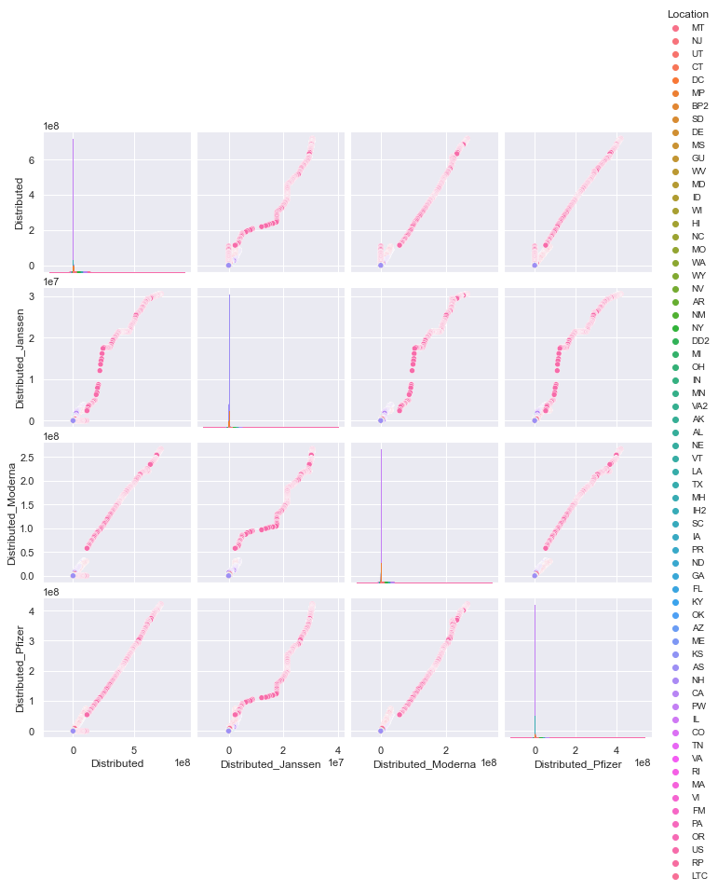
Univariate, Bivariate and Multivariate EDA

Slide 9
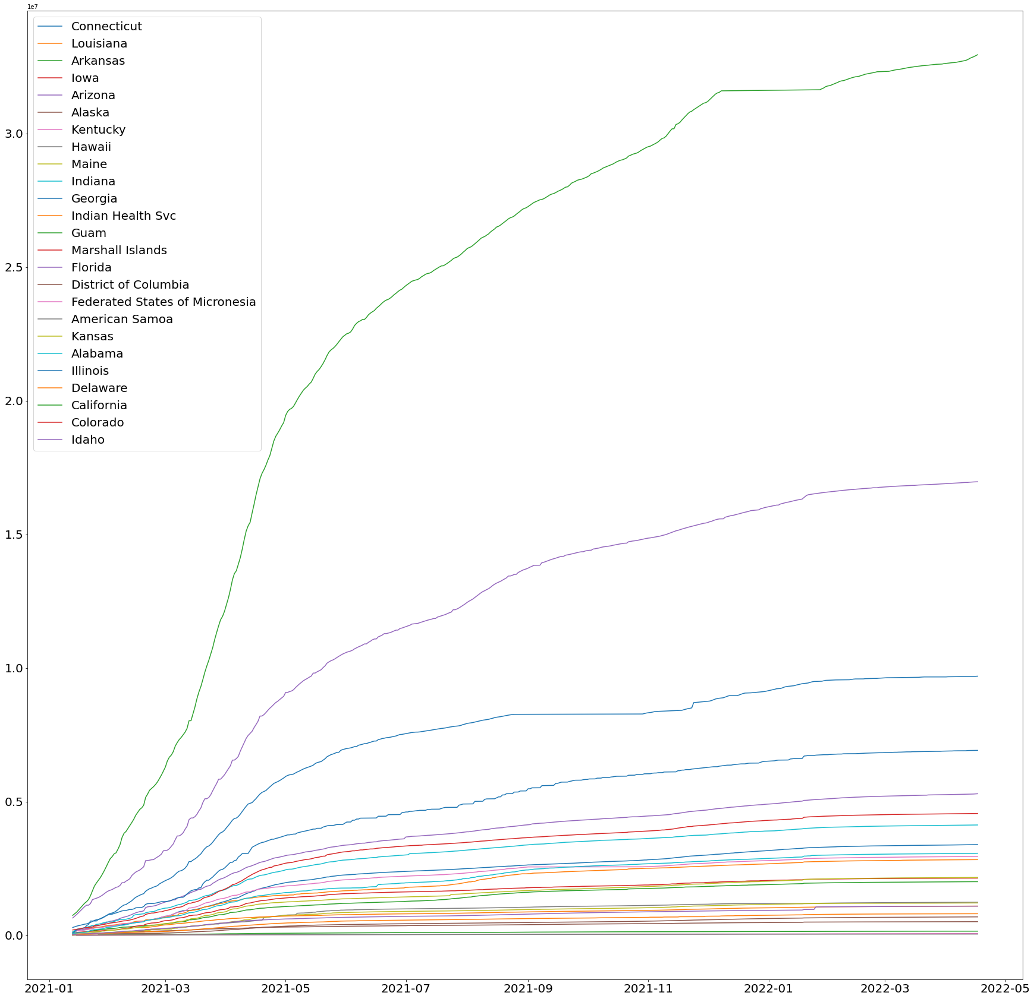
Results- Trends in different states
Notes:
Multiline graph

Slide 10
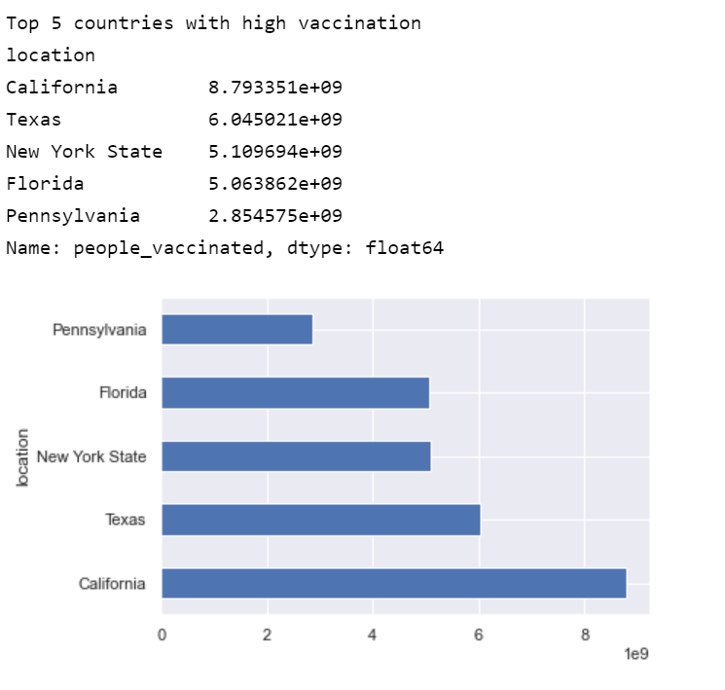
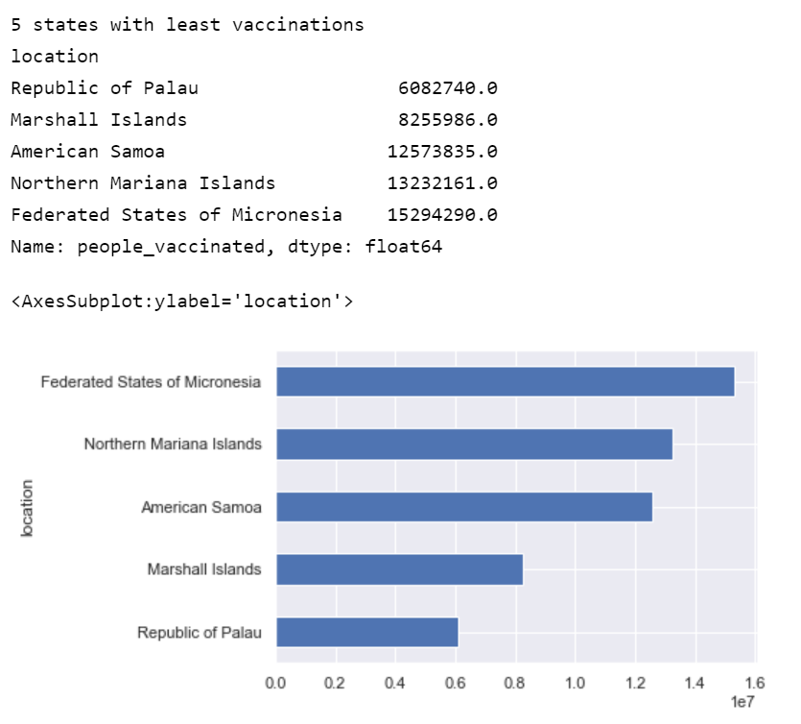
Results
States with Highest and least vaccinations
Notes:
Bar charts

Slide 11
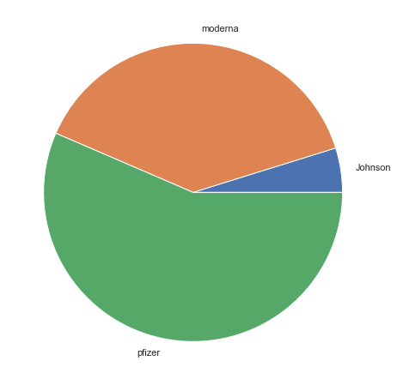
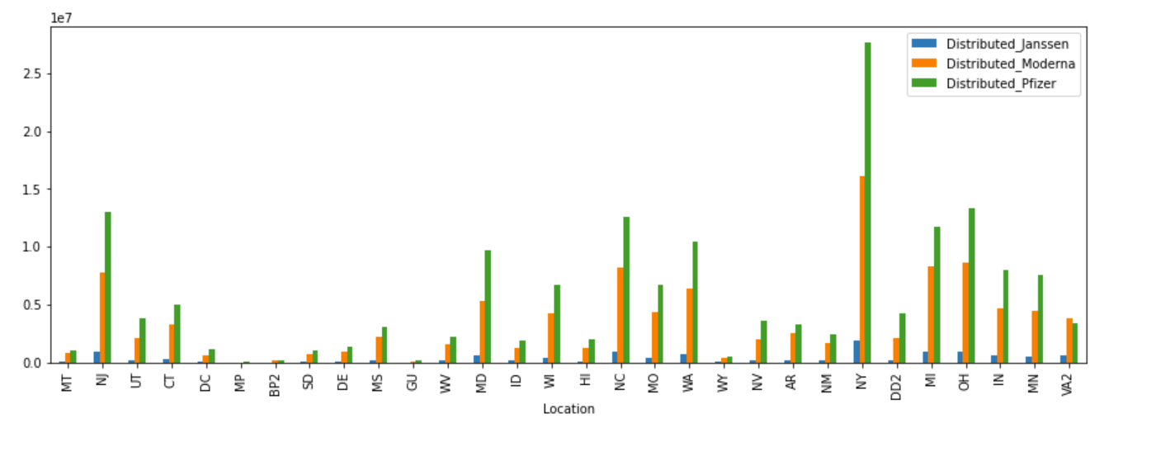
Results
Moderna/Pfizer/Johnson-Johnson
Notes:
Clustered Coloumn Chart and pie chart

Slide 12
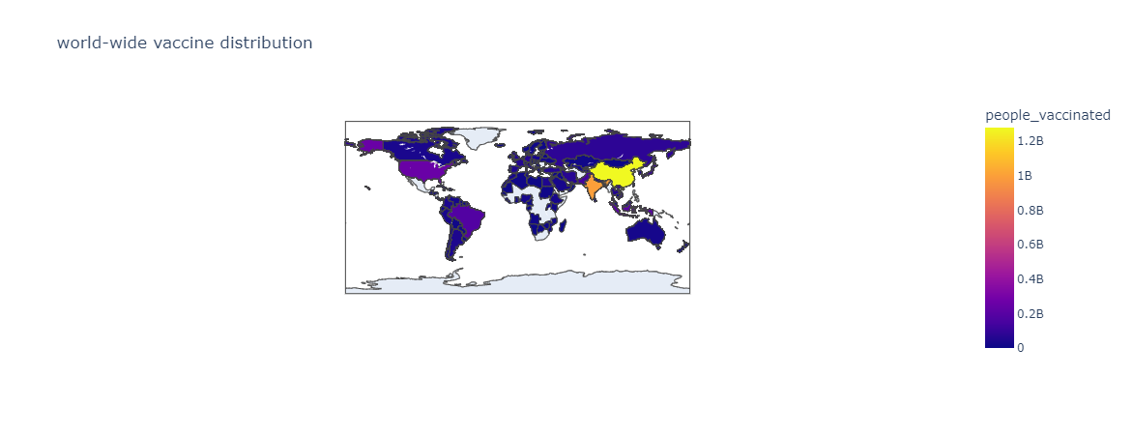
Results
Country-wise vaccination
Notes:
Choropleth Maps

Slide 13
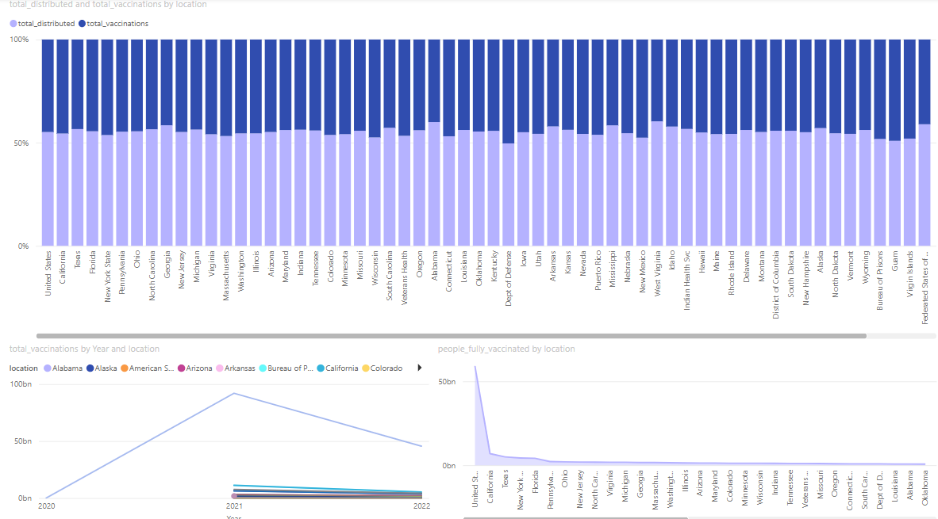
Results
People vaccinated vs vaccine distributed
Notes:
Dashboards

Slide 14
Conclusion and Future work
For any other vaccination distributions.
Helps people come over their fear of vaccine side effects.
By addressing fears and highlighting the extensive benefits of vaccinations, both specific to COVID-19 and other diseases, public health initiatives can improve vaccination rates and overall community health.

Slide 15

Thank you

